Slide 1
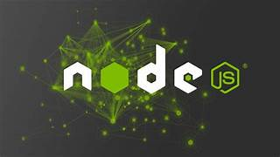
Presented by
D. Saravanan
MERN Stack Trainer
Credo Systems

Slide 2
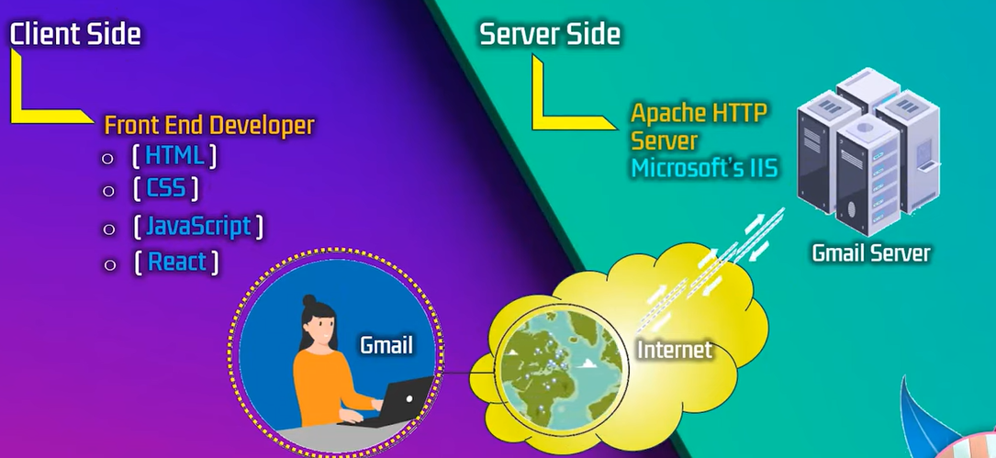
Server Architecture

Slide 3
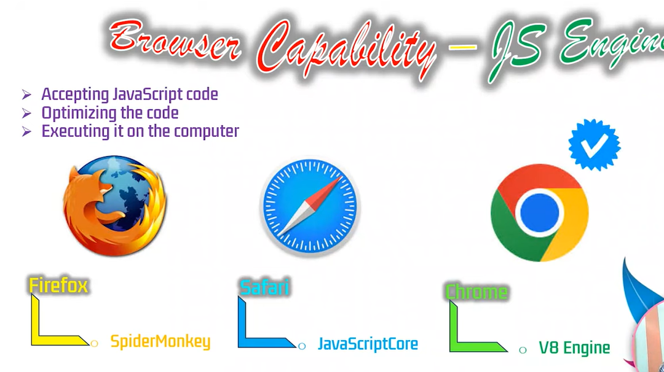
Browser Engine

Slide 4
Node JS - Introduction
Node.js is an open-source and cross-platform runtime environment for executing JavaScript code outside a browser.
You need to remember that NodeJS is not a framework, and it’s not a programming language.
that allows developers to run JavaScript on the server-side.
It provides an event-driven, non-blocking I/O model, making it lightweight and efficient.

Slide 5
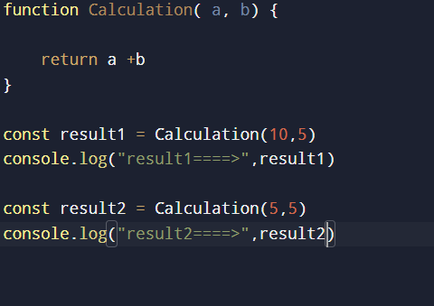
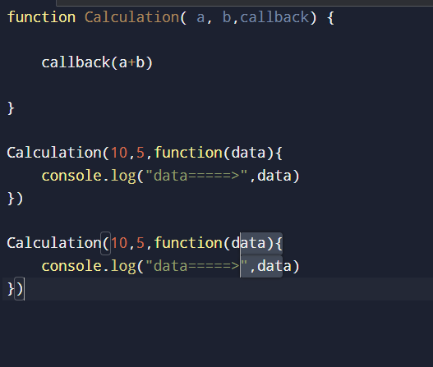
Blocking VS Non -Blocking
Blocking code
Non-Blocking

Slide 6
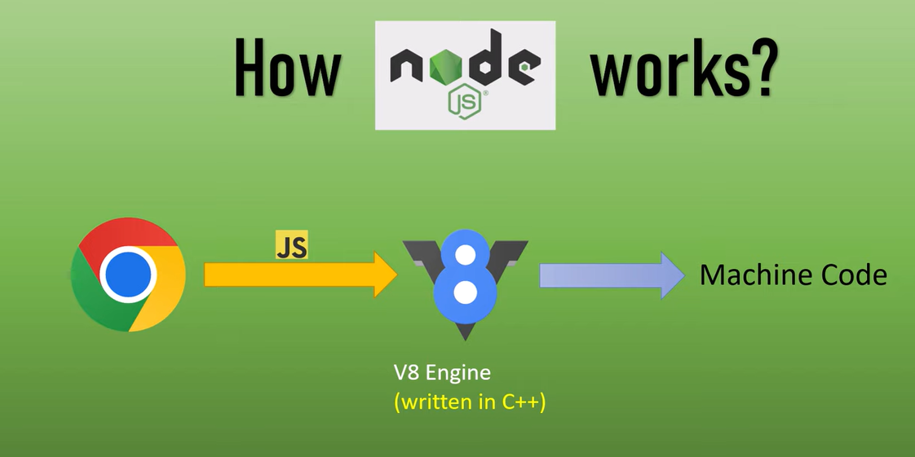
How Nodejs understand Web Request

Slide 7
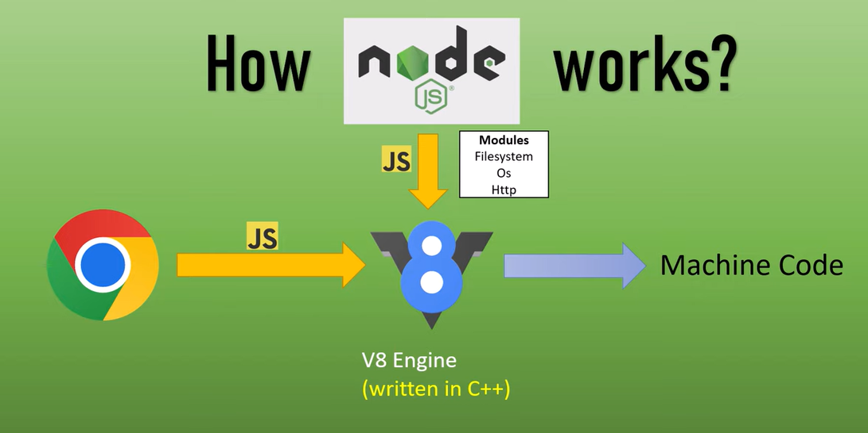
Node added features

Slide 8
Event-Driven Architecture
An event-driven architecture is a design pattern
that allows a program to respond to events or changes in the system.
In Node.js, events are used to handle asynchronous operations, such as I/O operations, network requests, and timer events.

Slide 9
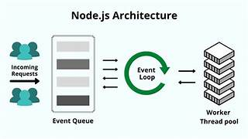
Event-Driven Architecture Diagram
Node.js uses an event loop to handle events.
The event loop is a single-threaded loop that continuously checks for new events and processes them one by one.

Slide 10
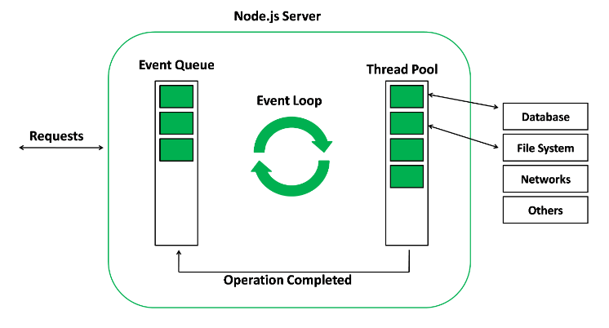

Slide 11
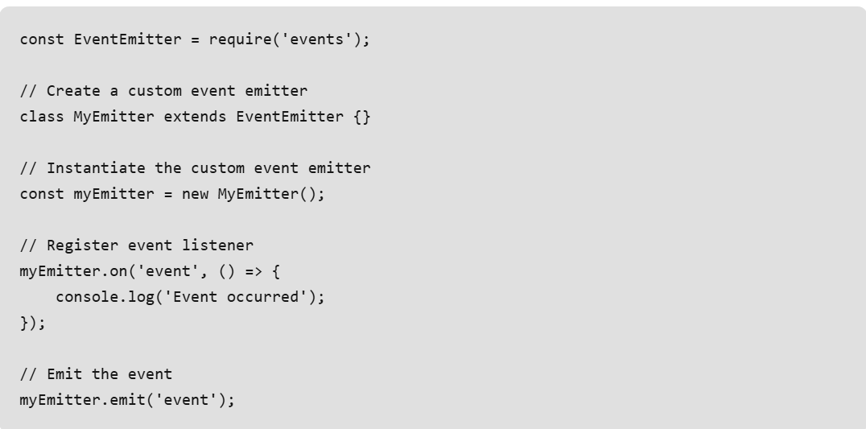

Slide 12
Key Features of Node.js
Asynchronous and Event-Driven
JavaScript Runtime
Modules and Packages
Cross-Platform

Slide 13
Nodejs – Advantages / Disadvantages
Advantages
1. Fast and Scalable
2. Easy to Learn
3. Large Ecosystem
4. Real-Time Applications
Disadvantages
1. Limited Multithreading
2. Callback Hell
3. Error Handling

